Slide 1

User-Centered Website Development: A Human-Computer Interaction Approach
Notes:
You don’t have to be an artist to teach this!!!
There is no drawing—beyond rough sketches that don’t have to be pretty—and nothing about color.
There are a few principles, which can readily be learned and taught.

Slide 2
Daniel D. McCracken
City College of New York
Rosalee J. Wolfe
DePaul University
With a foreword by:
Jared M. Spool, Founding Principal,
User Interface Engineering
PowerPoint slides by Dan McCracken, with thanks to Rosalee Wolfe and S. Jane Fritz, St. Joseph’s College

Slide 3

Credits
Slide 11: Courtesy of the Orpheus Chamber Orchestra.
Slide 13: Courtesy of Eddie Bauer.

Slide 4

5. Visual Organization
In this chapter you will learn about:
Four principles of visual organization and how to apply them
  Proximity
  Alignment
  Consistency
  Contrast
Notes:
At several places in the chapter we show how these principles tie in with the ideas of Gestalt psychology discussed in Chapter 2.
Also: for any student who shows a flair for this part of the subject, recommend getting Robin Williams’ marvelous and highly accessible book, The Non-Designer’s Design Book. See chapter references for details.
Williams uses “repetition” instead of “consistency.” Rosalee Wolfe says that her students found the term “repetition” confusing, since it seemed to suggest bland uniformity. Read Williams’ book and you’ll see this isn’t so, but we made the change anyway. A pity, in a small way: with Proximity, Alignment, Repetition, and Contrast you have the simple acronym PARC, which of course is French for “park.” Williams hints, but does not say, that an anagram of this would also be an acronym. You figure it out.

Slide 5
Visual Organization and Content Organization
Content Organization and Visual Organization go hand-in-hand
An effective layout reinforces a site’s content organization, and the result is easy navigation
Example: Indentations in programs
Developer’s point of view
  Content organization drives visual organization
User’s point of view
  Good visual organization makes it easy to locate content

Slide 6
Four principles for effective visual organization
Proximity
Alignment
Consistency
Contrast

Slide 7
Proximity
Gestalt principle
People tend to perceive items that are located close together as being related
Related items are grouped to convey content organization
Unrelated items are separated
Uses grouping of items

Slide 8
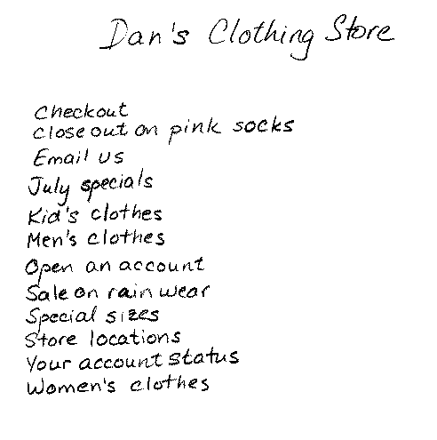
Dan’s Clothing: the mindless version
Notes:
Note the handwriting. This is not the main point here, but the choice is entirely deliberate: we want students to think in terms of sketching things out, quickly. We want students to be comfortable with sketches and handwriting when they come to paper prototyping.

Slide 9
What groups would make sense?
Women’s clothes, Men’s clothes, Kid’s clothes, Special sizes
July Specials, Sales on rainwear, Closeout on pink socks
Store locations, Store hours
Open an account, Your account status
Check out
Email us.

Slide 10
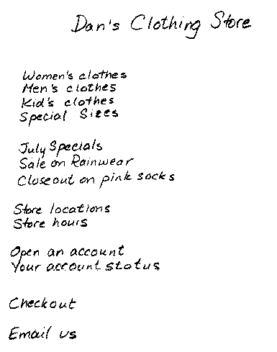
Dan’s Clothing: with sensible groups
Notes:
As review, ask what Gestalt psychology principle is related to this. Some people will remember Chapter 2, and say “Proximity!” Of course, such a student might also have read this chapter, where the point is made explicitly.

Slide 11
Alignment
The Gestalt psychology concept of continuity leads directly to Alignment
Related items are placed along an imaginary line
Align items of equal importance
Indent subordinate items
Good alignment maximizes the number of unbroken lines. See figure 5.5

Slide 12


Forms of Alignments
Left Alignment
  Most common form of alignment
Right Alignment
  Used in advertising
Center Alignment
  Commonly used for headings
  Weakest type of alignment because it forms fewer invisible lines than does either left or right alignment
  Do not used it on extended body text!
  Make the individual lines very different in length
Justified
  Align both the left and right margins
  Avoid in Web development

Slide 13
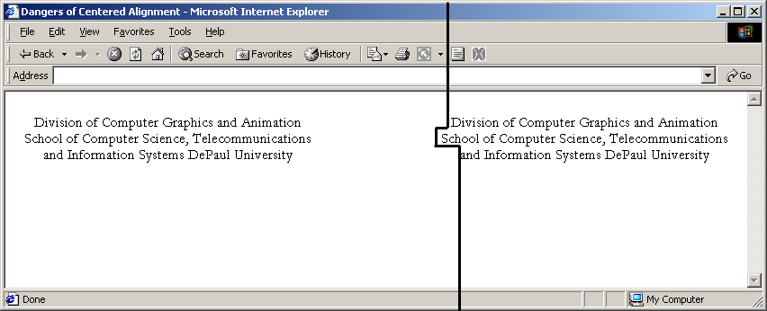
Avoid centered alignment for lines that are of nearly equal length

Slide 14
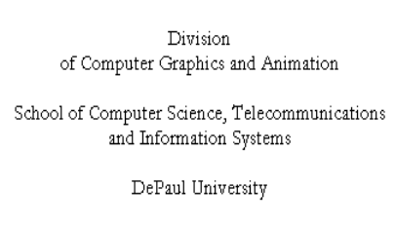
Lines are now greatly different in length: reader knows it’s intentional

Slide 15
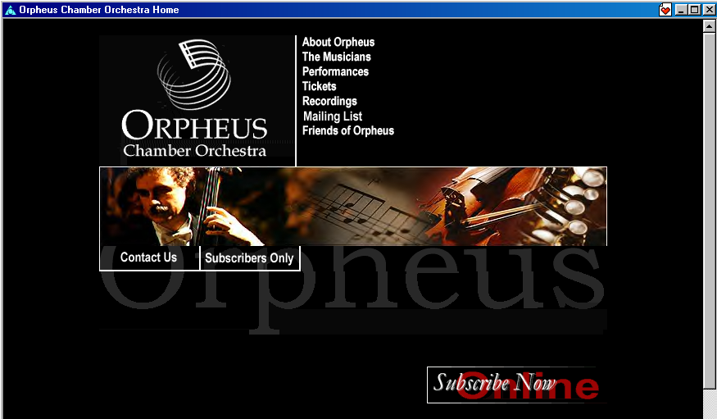
Orpheus Chamber Orchestra: nice use of proximity and alignment
Notes:
Ask students how they see the principles being applied. Maybe use the pen tool (Ctrl-P) to draw in lines showing alignment. You will want to right-click, once you have the pen tool, and change the color to yellow or white.
Note the darker gray background. The regular light gray background takes the punch out of this image. Also, the background graphic was removed; it was a total distraction. If you want to do any of this kind of thing, go to Format/Background. Be sure to use Apply, unless you really mean Apply to All. But if you make a mistake, Ctrl-Z undoes it. And you can repeat the Undo, to the depth of the stack of changes. The default is 20, but you can change that in Options/Edit.

Slide 16
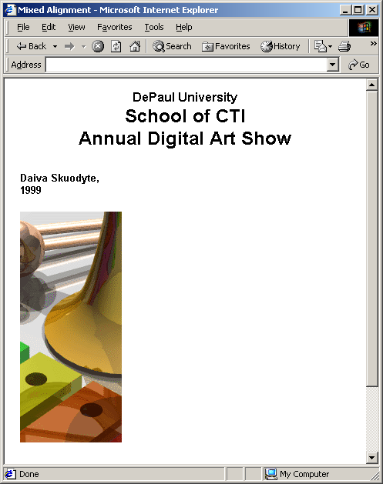
Don’t be a slave to centered alignment . . .

Slide 17
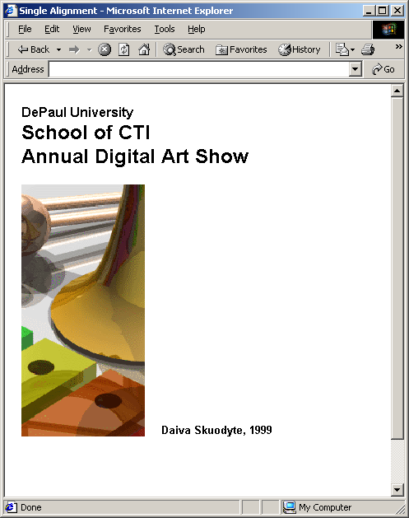
. . . which is OK, but isn’t this better?
Notes:
There is no accounting for taste. Some students may say, “No!” We are not doing exact science here. A graphic designer would see a dozen other ways to do it. Maybe right align the top text. Or try putting “Annual Digital Art Show” in biggest type that will fit with the line printed vertically.
In a graphic design course the instructor would say, “Let a hundred flowers bloom! Each of you: reformat this at least six other ways, and we’ll see what we like.” That’s the essence of the studio method, used for centuries in teaching art and architecture.
There will rarely be time to do much of that in an HCI course, but you may be able to encourage a little experimentation. Once you establish the groundrule that criticism is expected to be constructive, students will help each other—with your guidance, of course.

Slide 18
Consistency
Make related items look the same
High degree of uniformity in layout within a page
Uniformity in layout across pages
Examples
  Navigation bar on the left side of every page
  Making all the buttons the same size
  Putting the link to the home page in the same place on each page
  Consistency of alignment
  Consistency of visual metaphors

Slide 19
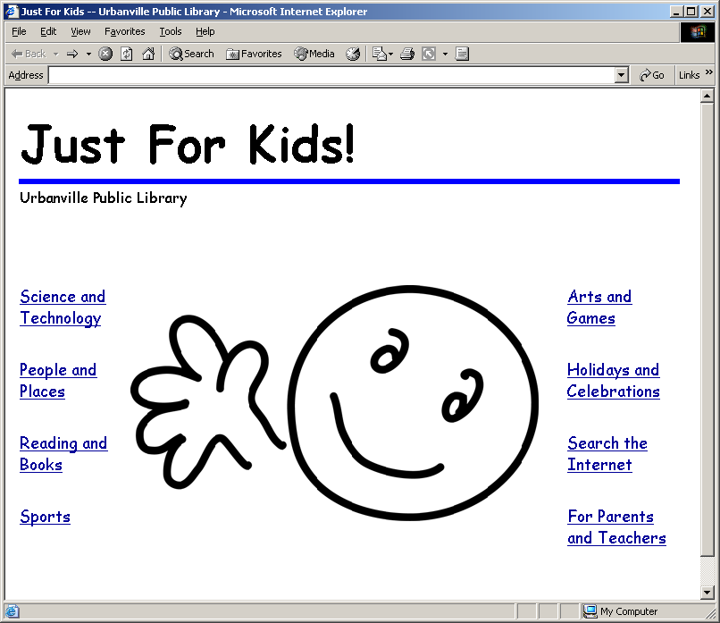
Note the consistent layout in the next few slides
Notes:
Figure 5.12 and following were drawn by Rosalee Wolfe. We wanted to use the New York Public Library site, http://www2.nypl.org/home/branch/kids/ but we could not get permission. That doesn’t stop you from going there live.

Slide 20
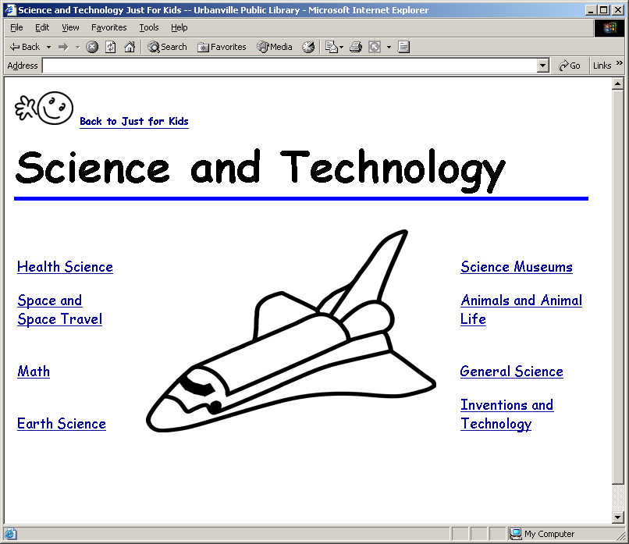
One of the pages reachable from the previous slide

Slide 21
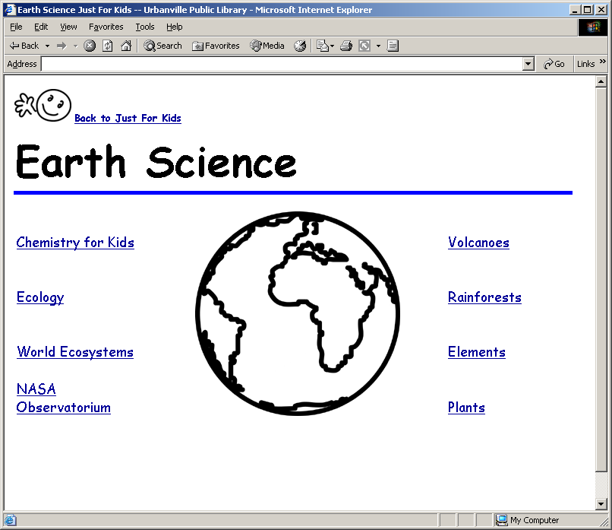
One of the pages reachable from the previous slide

Slide 22
Contrast
Make different items look different
Can draw attention to items on your page
Text that is large and bold will be perceived as being more important than smaller text
When you decide to make two items different, make them really, really different

Slide 23
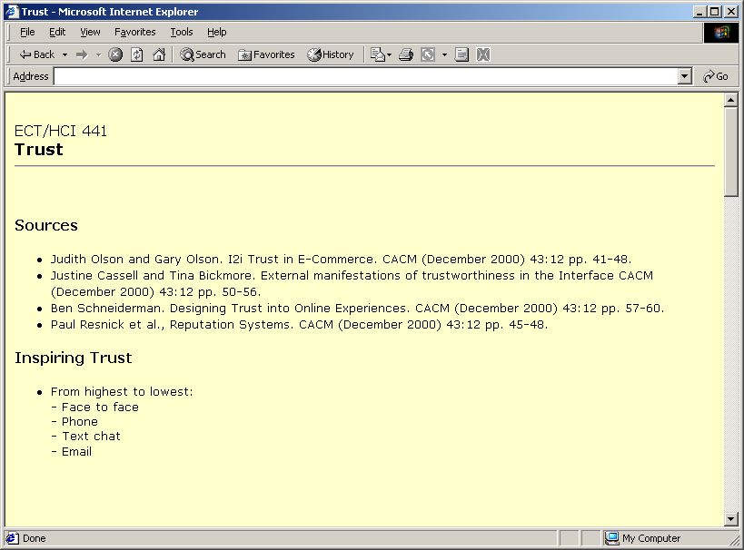
How can we make this more interesting?

Slide 24
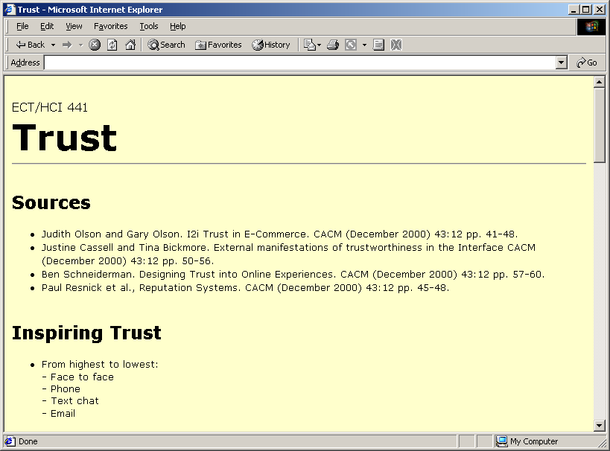
Use more contrast
Notes:
Or a lot of other ways. The goal here isn’t to provide algorithms, which don’t exist, but get students to think about visual impact, and to get them to experiment. And to be bold. Most of your students will have no background in graphic design, and will tend to be tentative about this stuff. (If you do have a student with a broader background, find some way to exploit it. Encourage the CS/graphic design combination, which has market value. Showcase that student’s work, in some way that doesn’t embarrass him. Maybe let her give a ten minute mini-lecture about something. I’ve had a handful of such students in my Web design course, and they can be a delight.
One of Williams’ slogans is, “Don’t be a wimp!” Translation: if you’re going to use contrast, make it a LOT of contrast, so people will know you meant it.

Slide 25
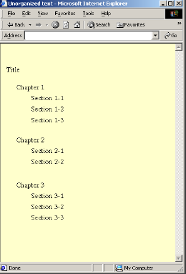
Talk about boring!
Notes:
This is drawn from Exercise 12. See the Instructor’s manual for a discussion of the various changes shown in the exercise, where the changes are considered one at a time.

Slide 26
This is a quiz! (Not really)
Look again at the previous slide.
  How many ways can you improve it?
  Can you put all four principles to work?
  Next slide shows one possible way
  You can find lots of others
Notes:
I used this example on a quiz, simply asking students to show how all four principles are used. Most got it, and it made for a good review.

Slide 27
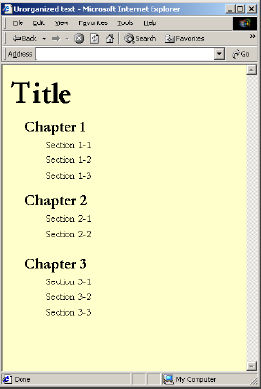
Here’s one way, but there are many other possibilities
Notes:
If your course involves any kind of implementation, students will have prototypes at some point (see Chapter 7, Prototyping). If their designs are boring visually, that’s a good chance to remind them of the ideas in this chapter.
BUT: if your course involves Web implementation, sizes contrast like this must never be achieved by skipping heading levels, e.g., using <h1> for the Title, <h3> for the Chapter, and <h6> for the Section. This makes things harder for blind users who are listening the a screen narrator. Use styles!

Slide 28
The principles are seen in combination
Eddie Bauer site (next slide) has
  Horizontal alignment
  Vertical alignment
  Proximity, to group like items
  Consistency, in type size and font for links
  Contrast, between SALE and most else

Slide 29
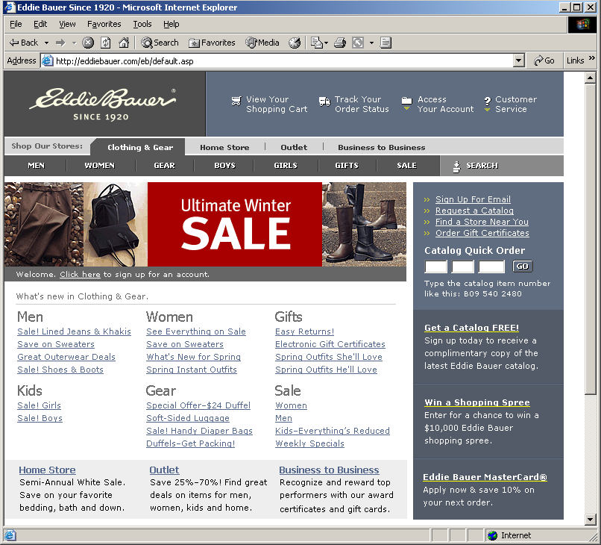

Slide 30

Summary
In this chapter you learned:
Four principles of visual organization
  Proximity
  Alignment
  Consistency
  Contrast
Some ways they can be applied
The message:
  There are principles; your can learn them and use them
Notes:
Be sure at some point to make the connections between this chapter and Chapter 2 (the Gestalt psychology part), Chapter 4 ( Content Organization), and the upcoming Chapter 6 (Navigation Design). The whole subject makes more sense if students can see the connections, the way it all hangs together.
The last bullet is not to be taken too literally. We don’t encourage “font madness” or gratuitous color changes. The thing is, many students, at least in computer science, have to be given a shove to do anything innovative. They tend to color inside the lines, so to speak. Not all, of course. I think, on balance, it’s good to push these folks outside the box, and then rein them in if they go too far. It’s hard to say, “Experiment, but not too much.” Let them do “too much,” and then help them pull back a bit.
One fruitful approach: give a relatively free-form assignment, then let the class look at everybody’s work. The timid folks will get encouragement to be bolder; the ones who were too bold will see that. Quiet, non-judgmental peer guidance.
This is the studio approach again. We couldn’t very well do it in the book, but you can do it in class. Without being an art teacher! I’ve taken Graphic Design 101, and I know this is how it’s done, but you don’t have to do that to set up a classroom situation where the students mostly teach each other. Sound like smoke & mirrors? Try it. You might be surprised.

